Slide 1
What is it?
Why do we need it?
Prof. Aldo Drago
SHAREMED Project Specialist
Istituto Nazionale di Oceanografia e di Geofisica Sperimentale – OGS
aldo.f.drago@gmail.com
We cannot do better than what we do together
Notes:
Why do we need an FD... 30 y saying the same things... Doing bits and pieces but without a real agreed and decisive plan...still unharmonised... NS gap... Lot of duplication... Not even if we have the money do we know exactly what to do

Slide 2
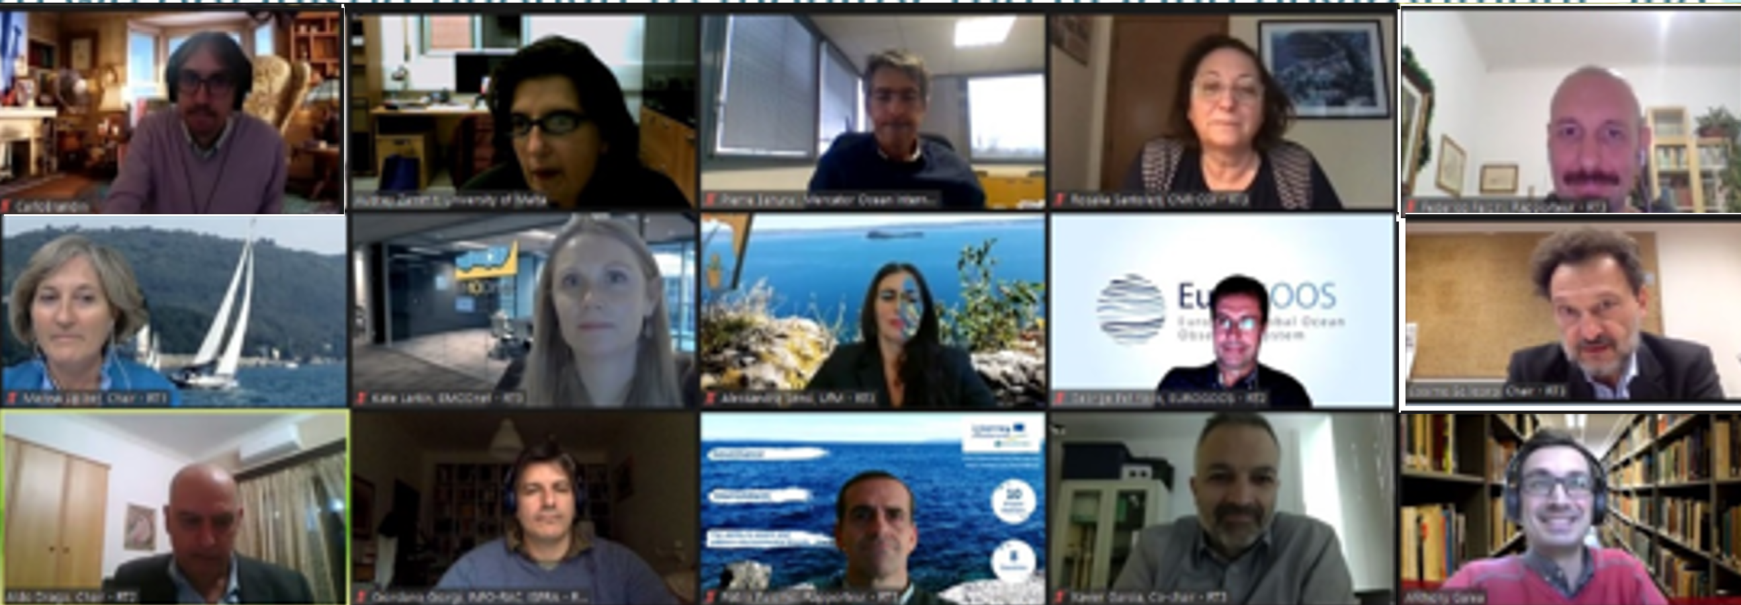
Capitalisation Workshop in 2020
Expert Groups
Stakeholder questionnaires
Stakeholder consultative meetings
Capitalisation from previous projects
Engaging with existing initiatives/programmes/projects
How did we do it?
Expert group for Marine Observations
Aldo Drago as chair
Cosimo Solidoro as PL and for OGS
Inga Lips on behalf of EOOS
Wehde Henning for EuroGOOS
Adriana Salazar Olivan, Alessandra Sensi and Giovanni Provenzano for UfM
George Petihakis for HCMR
Federico Falcini for CNR
Carlo Brandini for LAMMA
Christian Grenz for MIO
Carolina Cantoni for JERICO-S3
Vanessa Cardin and Alejandro Orfila for MonGOOS
Rosalia Santoleri for UN Ocean Decade
Marina Lipizer for OGS

Slide 3
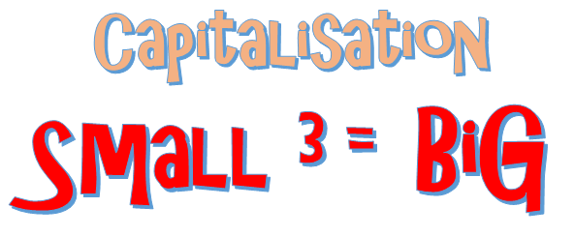
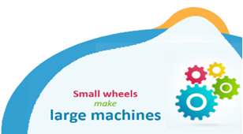
Actions to serve as building blocks
Capitalise on what we have
More than combining what we do separately
Political will and mandate
Aldo Drago - SHAREMED internationalisation workshop, 13th / 14th September 2022, MALTA

Slide 4
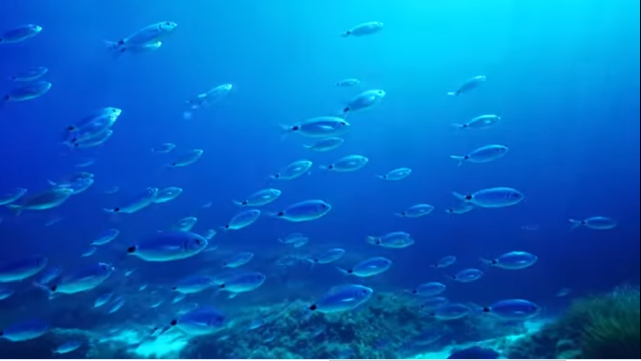
Setting common principles and facts and targets
Key ingredients
oceans do not distinguish political boundaries;
the power of data is exploited by sharing;
we cannot manage what we do not measure and observe;
multiple-purpose and multi-functional observing systems boost the cost-benefit paradigm;
the principles of co-design and co-development is more than combining what we do separately;
effective capacity building requires self-empowerment of the recipients to enable self-reliance and independence from the source;
the sharing of ideas, assets and commitments towards common goals within and across countries is the capital needed to build momentum and critical mass;
the problem of marine threats, risks, hazards and pollution in the Mediterranean cannot be under-estimated;
ocean services to society gain importance as we strive to intensify multiple uses of the sea
If we do not agree on common principles, it is useless to start
Notes:
key enabling guiding principles and common targets, setting the basis of a harmonised and shared agenda for a regional marine observation system of systems that we need for the future Mediterranean that we want, to be achieved by complementing and synergising efforts towards an affordable, co-designed and joint integrated sustainable endeavour in the region.

Slide 5
Six Principal Action Points
Relying on proven experience
The Regional Network of National Marine Core Data Services
2. Building effective regional collaborative efforts
3. Capacity development and technology transfer
4. Adoption of an ocean digital ecosystem
5. The marine observing system of systems we need for the future Mediterranean we want
6. Governance Frameworks that work
The plan exploits the resources
…. the design fits the needs

Slide 6
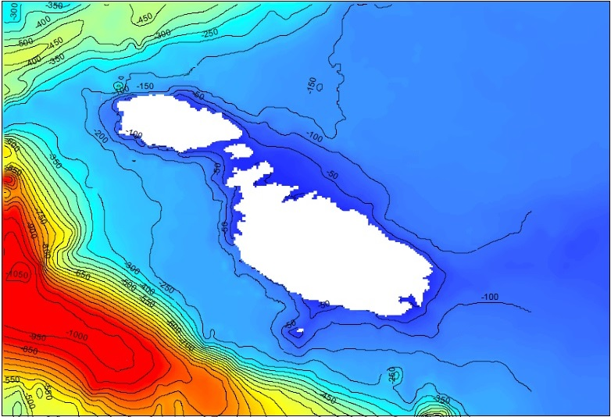
What and How ?
Strategy for Marine Observations
- National observing systems focus on observations in the coastal scale…..get the regional scale from joint programmes
- Use numerical models to plan and to interpret observations intelligently
- Merge earth observations by satellites with a cascade of buoys in the offshore, coastal and nearshore marine domains
- Nearshore marine ecosystem observations supported by low cost systems, continuous and adaptive observation platforms, and by planned regular ecological surveys
- Observations in the coastal seas are assimilated in coarser models and provide improved BCs for super HR models in the nearshore areas
- Physical sea conditions and circulation in the nearshore areas from primary models
- Process models at ultra high resolution in the nearshore areas to assess ecosystem functioning pragmatically
Numerical models extrapolate observations to view the whole perspective
Notes:
you know I do not agree on the observation approach tout-court without a validation of a model to be designed in advance. We have a lot of data and the experience from atmospheric research has tough that data are useful but not crucial provided a good theoretical framework is appropriate. Complex systems with many variables cannot be understood by the description of the properties/behaviour: we need a boost in modeling before asking a deluge of [expensive] data. So, ecosystem services are a fantastic product for short-term management and economic use, but accurate predictions of the dynamics of the anthropogenic impacts on marine environment are still a middle-age story.
So, I suggest to introduce more emphases in the paragraph We cannot manage what we do not measure and observe on models and cross-disciplinary contribution from other scientific domains in data analysis.

Slide 7
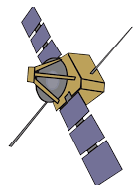
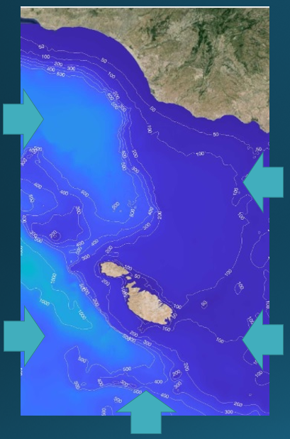
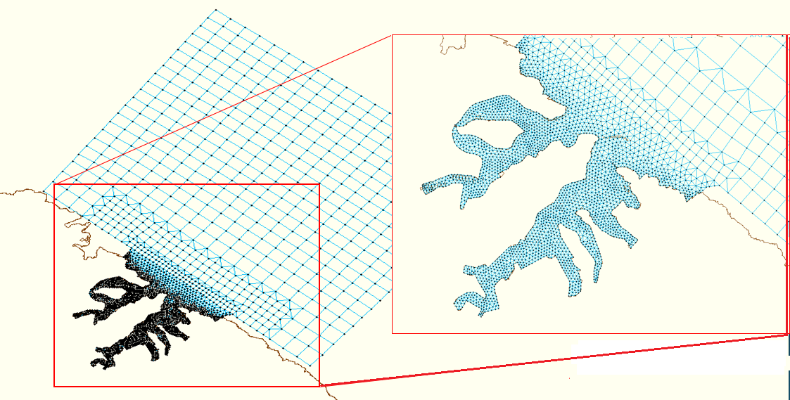
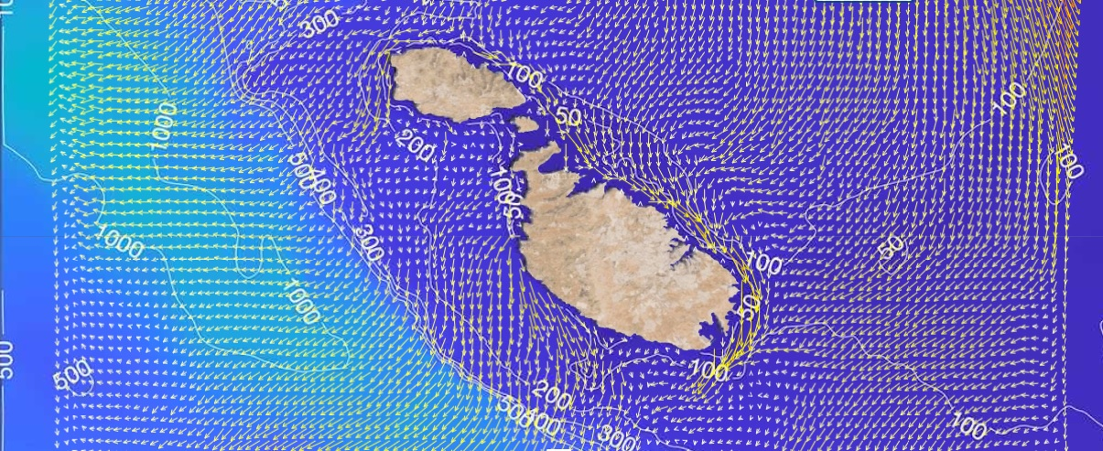
RESOLVING THE COASTAL AND NEARSHORE SCALES BY INTEGRATION TO NUMERICAL MODELS
shelf
coastal
nearshore
Aldo Drago - SHAREMED internationalisation workshop, 13th / 14th September 2022, MALTA
Notes:
Q3./ The coastal seas present a formidable challenge to understand their intricate hydrodynamics.... even more complex when it comes to understand the biogeochemistry and how the physical forcings impact and link to the biology. The coastal ocean is a dynamic area, with high spatial and temporal variability, enhanced diurnal variability, and with other processes to be accounted for when compared to the open ocean. The challenges are indeed of a more complex nature than in the shelf and ocean scale.... There is also the interaction with the land on one side, and the forcing by the shelf water on the open sea end. Which are the observation strategies needed to capture the intricacies of the coastal seas to the level need by users? ….eg What to measure and where in a gulf or coastal embayment; some guidelines on how to do observations?
Cascade of buoys
Providing observations at different scales
Offshore buoy to monitor the larger scales and use with regional and shelf scale models
Coastal buoy providing direct observations for BCs or assimilation in ultra high resolution nearshore models
Nearshore observing stations in the form of multi-parametric benthic landers measuring biochemical parameters, underwater noise, nutrient/sediment loads, pollution……and sustained by functional routine monitoring of the marine ecosystem components (fauna, flora and habitats) through a set of essential variables
Ultra high resolution models are translocatable models that can be applied in different nearshore marine areas to provide simulations of basic physical parameters describing the thermodynamics and energy/water fluxes (currents, waves, S and T, air-sea fluxes); process models describe ecosystem processes including biogeochemistry, sediment fluxes, water quality, ecology.
For sure observations on their own are not sufficient to monitor hazards in the dynamic coastal zones which are characterised by shorter-scale variability.
While satellite observations are an essential source of information to monitor metocean variables that are relevant to coastal hazards, they are often limited to the ocean surface, and do not provide the temporal coverage required at the coastal scale. Integrating satellite observations of the ocean surface and sparse in situ coastal observations into operational numerical global, regional or coastal models enables a synoptic 4D monitoring of the many ocean variables, including those non-observed variables, and improves the models’ accuracy and prediction skills (e.g., Le Traon et al. 2015; Tonani et al. 2015).
Q2./ It is probably a common approach that of using observations, principally EO, in the offshore marine domains to assimilate into numerical models and use models to improve the knowledge and forecasting skills of ocean scale and shelf scale dynamics and processes. We then use downscaling techniques with higher resolution models to reach closer to shore, check against observations in the coastal areas, and thus resolve the needs to extended assessments in gulfs, coastal embayments, river deltas and coastal sea domains in general where certainly no practical coastal observing can resolve the scale of processes in such domains.
.... Is this approach the most sensible to follow? Are there other solutions that can be proposed?
The more commonly assimilated satellite observations in ocean models are SST, sea level, Chlorophyll-a concentration, significant wave height (with progress regarding the assimilation of directional wave spectra), and sea-ice parameters. As for atmospheric models, used to force ocean models, they also assimilate EO data, notably scatterometer ocean vector winds, SST and significant wave height (e.g., ERA5 reanalysis, Hersbach et al. 2019).
Such integrated systems are the backbone of reanalyses (coherent historical representation of the ocean state over the past decades) and short-term forecasts (up to 10 days) of the physical and biogeochemical ocean states. The outputs can then be used for diverse applications related to coastal hazards.

Slide 8
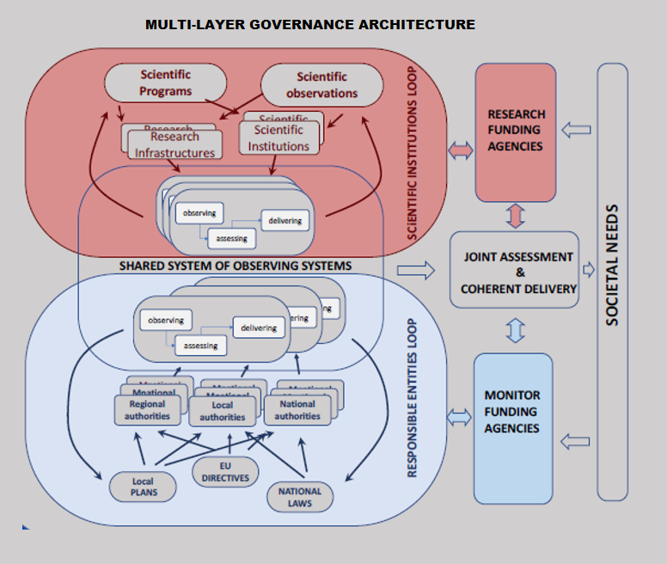
connecting the scientific institutions loop (institutions and infrastructures focused on observations for science and research) with the responsible entities loop (national and regional authorities and stakeholders with roles in monitoring, policy, management and security) to share and use the same data for joint elaborations, assessments, and coherent delivery to support and address societal needs
Notes:
An ambitious set of guiding proposals are set in the Framework Document aiming to design, build and implement the multi-scale system of marine observations. These actions do not come without bottlenecks and major hurdles to overcome. The envisioned multi-level governance approach provides the pillars to primarily connect and synergise the numerous and diverse actors within and across countries, operating at different institutional, geographic and sectoral levels; it stimulates the greater involvement of the broader user community to better align with societal needs, supports the science-policy interface, and steers the sustainable development of the sea. More than a creation from scratch, it relies on proven experiences such as the Barcelona Convention and its engagement with the Contracting Parties covering most of the riparian countries, within which an enhanced approach can find its roots and evolve; further utilising existing mechanisms such as the Joint Programming Initiative Healthy and Productive Seas and Oceans (JPI Oceans), and the Sustainable Blue Economy Partnership (SBEP) that can be adopted to specifically fit the Mediterranean context.

Slide 9
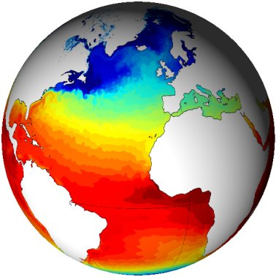
COPERNICUS Marine Core Data Platform
Prof. Aldo Drago, Course Coordinator
CMEMS Multiplier Effect
CMEMS
USERS
Intermediate
Users
USERS
APPLICATIONS
USERS
USERS
Notes:
Of particular importance for the monitoring of coastal metocean conditions and hazards are the marine and land services of Copernicus (aka CMEMS
and CLMS, respectively). These two complementary services are developing their offer for coastal zone users. For instance, CMEMS is currently providing satellite level-3 and -4 data for many relevant metocean variables as well as global and regional reanalyses, nowcasts, and forecasts of the ocean physical (including waves) and biogeochemical states.
CMEMS is continuously evolving with more coupled models, increased resolution, improved algorithms to better process satellite observations in the coastal zone, etc.
CMEMS will keep evolving in the long-term to monitor and forecast the ocean at finer scales, to improve the monitoring of coastal zones, and to provide a more seamless and better forcing for very-high resolution coastal models (Le Traon et al. 2019). Finer-scale upper-ocean dynamics and surface currents monitoring and forecasting in particular is essential for key hazards such as maritime safety, maritime transport, search and rescue, drift modeling, riverine influence in the coastal environment, pollution monitoring and offshore operations. Yet, regional high-resolution modeling (e.g., (sub)kilometric scale) comes with challenges for the integration of high-resolution satellite (e.g., wide-swath altimetry) and in situ (e.g., HFR) observations. CMEMS and CLMS are also targeting a better dynamic characterization of the coastal zone (Sect. 2) and of river discharges monitoring and forecasting.
This is going to open up large data realms and local sources as the demand for data is expected to make paradigm leaps since it is being considered as an essential ingredient for economic growth in general in the national data ecosystem. The proposal is then to help nations follow common paths towards organising their national data and it is essential are similar and not just compatible.
Moreover member state systems are closer to the user niches and better serve the national needs in the first place.

Slide 10
Marine Core Data Servicer by national systems
Prof. Aldo Drago, Course Coordinator
Evolving CMEMS……the National Marine Core Data Service
CMEMS
USERS
National MCS
Intermediate
Users
USERS
USERS
APPLICATIONS
USERS
applications
USERS

Slide 11
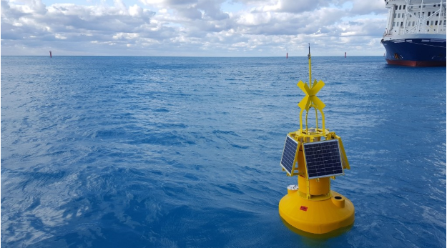
National Marine Observing Systems
Backbone and building blocks
target stakeholder needs,
serve to meet the monitoring obligations in coastal seas,
adopt a participatory bottom up approach at the local user community scale,
link data to local industry and to the specific society needs,
support national targets,
mentor capacity building,
plan, fund and implement the local efforts for marine data acquisition, management and dissemination,
run the integrated national marine core data service
operate through permanent entrusted local entities, are supported by appointed expert national committees and task groups embracing scientific and technical hands-on persons responsible to fulfill the practical and operational execution and delivery roles.
NSs acting together within a wider regional system, link the local scales to the transboundary dimensions
Notes:
NO ONE COUNTRY CAN DO IT ON ITS OWN
you know I do not agree on the observation approach tout-court without a validation of a model to be designed in advance. We have a lot of data and the experience from atmospheric research has tough that data are useful but not crucial provided a good theoretical framework is appropriate. Complex systems with many variables cannot be understood by the description of the properties/behaviour: we need a boost in modeling before asking a deluge of [expensive] data. So, ecosystem services are a fantastic product for short-term management and economic use, but accurate predictions of the dynamics of the anthropogenic impacts on marine environment are still a middle-age story.
So, I suggest to introduce more emphases in the paragraph We cannot manage what we do not measure and observe on models and cross-disciplinary contribution from other scientific domains in data analysis.

Slide 12
National Marine Observing Systems
Backbone and building blocks
While national systems run autonomously they will need to adopt similar structures (not only compatible), with interoperable functioning to synchronously and seamlessly connect and interact with peer systems in other countries as a federated system of systems. They follow and align to an accepted co-designed and shared overarching regional marine observation implementation plan and framework that evolves in time and guides for synergies, complementarity and joint development as a coordinated regional system.
NSs acting together within a wider regional system, link the local scales to the transboundary dimensions
Notes:
NO ONE COUNTRY CAN DO IT ON ITS OWN
you know I do not agree on the observation approach tout-court without a validation of a model to be designed in advance. We have a lot of data and the experience from atmospheric research has tough that data are useful but not crucial provided a good theoretical framework is appropriate. Complex systems with many variables cannot be understood by the description of the properties/behaviour: we need a boost in modeling before asking a deluge of [expensive] data. So, ecosystem services are a fantastic product for short-term management and economic use, but accurate predictions of the dynamics of the anthropogenic impacts on marine environment are still a middle-age story.
So, I suggest to introduce more emphases in the paragraph We cannot manage what we do not measure and observe on models and cross-disciplinary contribution from other scientific domains in data analysis.

Slide 13
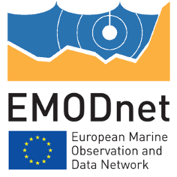
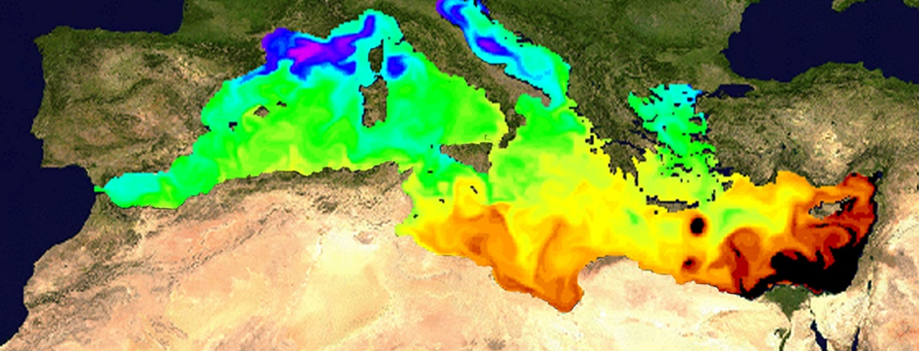
Role of national systems
Challenge of MS to coordinate large datasets, needing to adopt a harmonised approach to data management (commons standards) to enable an efficient subsequent integration of data that reaps the full benefits to users
MS need to build, organize and maintain their baseline data in a seamless, interoperable and synergistic system........such systems need to be similar and not just compatible? ….linked by machine-to-machine communication
Design with NSs serving as building blocks for coastal and HR marine data COPERNICUS-like national marine core data systems linked to CMEMS and EmodNET
COPERNICUS
National desk(s) to link to local users
Setting targets for commitments to invest in national capacities for coastal sea observations & forecasting
MEDITERRANEAN
PLATFORM
Baseline data integrating different types, scales and domains
Could a platform of platforms federating national systems to a Med Platform work?
National System
National System
National System
National System
National System
National System
National System
National System
National System
National System
National System
National System
Notes:
Hierarchical structure (left) composed of a coordinating parent platform linked to a layer of national clone platforms forming an integrated platform of platforms….design built on the concept of a parent and members family structure……Hierarchical structure relying on a network of national system nodes coordinated by a super platform
Technology including blockchain and cloud services with hyper functionalities is now allowing more sophisticated methods of federating activities and we could for example envisage a federated/congregated structure (right) consisting of peer platforms composed of national systems connected and interacting at the same level synchronously and seamlessly with no hierarchy, but functioning as one platform of platforms

Slide 14
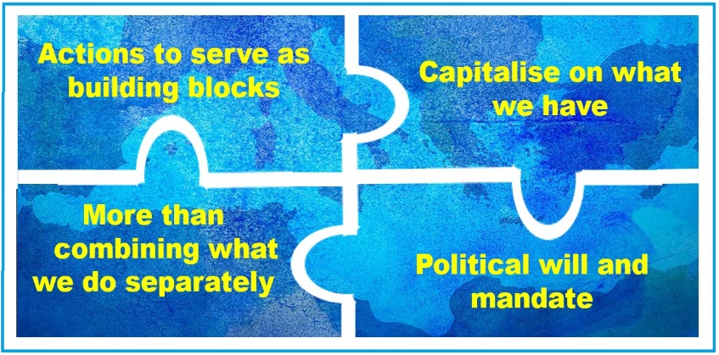
A Mediterranean Agency
- planning, co-ordination and direction at the regional level
- an implementing focal point in each country
- builds on existing coordination frameworks
Its main role is to bring countries together, manage the regional structures and synergise efforts across national systems, set the minimum national obligations on marine observations, exploit international initiatives like the UN Ocean Decade, seek combined political thrust through the regional mechanisms, exploiting existing arrangements.
Is this what
we need?

Slide 15
A Mediterranean Agency
Is this what
we need?
The Agency is set to promote regional endeavours with large
scale impacts and targets on a Mediterranean collaborative scale, with
joint implementation efforts by all the countries, aiming to tackle
and solve common problems and challenges together, especially those of trans-boundary nature.
New way of acting together by adopting regional collaborative programmes, rather than groups of complementary projects, which would be designed and run by the countries together, to achieve and dovetail country-based systems in their combined performance at regional level, and jointly achieving common targets with long lasting and sustained solutions.
Can you imagine a project setting up the same observations in each Med country?

Slide 16
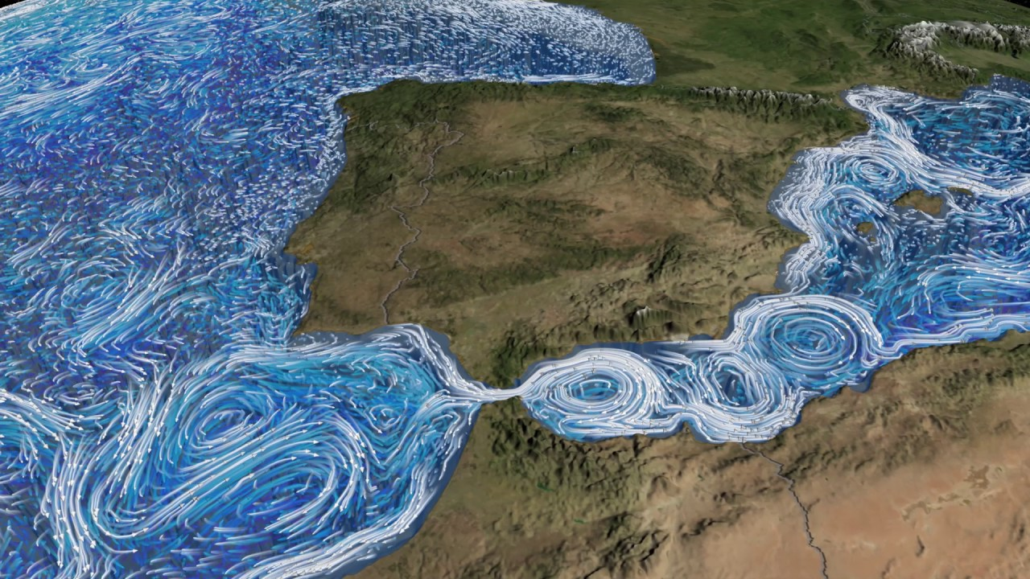
Next Steps Forward
The SHAREMED legacy
How should we best use the SHAREMED workshop in Malta? .....organising the round table
Raise document to a declaration…..what is needed?
Which major initiatives to link to?
Which actions to take?
Will it take us another 30 years to realise that we have not done enough?

Slide 17
CONTACTS AND FOLLOW UP
Prof. Aldo Drago
aldo.f.drago@gmail.com
OR
aldo.drago@mcast.edu.mt
Professor in Oceanography
Institute of Engineering & Transport
Malta College of Arts, Science & Technology
Aldo Drago
SHAREMED Internationalisation Workshop Malta 2022

